Slide 1



Migration to ASP.NET Core: Considerations & Strategies
@Scott_Addie

Slide 2
Agenda
Upgrade Paths
Application Model Support
.NET Core Value Proposition
.NET Core Tooling Considerations
Assembly Portability

Slide 3


You Are Here
ASP.NET 4.6
.NET Framework 4.6
Operating Systems
Editors VS 2015
Web Server IIS
Distribution OS
Notes:
ASP.NET introduced in 2002
Best candidate for ASP.NET Core = MVC or Web API

Slide 4


Determine Your Upgrade Path
ASP.NET Core 1.1
.NET Framework 4.6.2
.NET Core 1.1
net462
netcoreapp1.1
Operating Systems
Operating Systems
Editors VS 2015+, VS Code*
Editors VS 2015+, VS Code VS Code
Web Server IIS, Kestrel
Web Server IIS, Kestrel, HttpSys Nginx, Kestrel
Distribution OS
Distribution w/ or w/o App
* Debugging not currently supported
Notes:
.NET Core App Deployment Options
Framework-dependent
Self-contained
IIS reverse proxies HTTP to Kestrel
Kestrel doesn’t provide port 80/443 forwarding
Treat Kestrel just as your app server; not yet blessed as public-facing edge server
.NET Core not really a subset; has its own unique APIs & tooling
.NET Standard Library has become new Base Class Library (BCL)
Popular APIs missing in .NET Core:
System.DirectoryServices
No LDAP / AD support
System.Drawing

Slide 5
Supported App Models
ASP.NET 4.6
VB or C#
MVC
SignalR
Web API
Web Forms
Web Pages
Notes:
Containers
No machine-wide installation
App isolated from machine-level patches

Slide 6
Supported App Models
ASP.NET Core 1.1
C#
MVC
Web API
Notes:
Containers
No machine-wide installation
App isolated from machine-level patches

Slide 7
The Value Proposition of .NET Core
X-plat
Open source
Everything is a dependency (cafeteria plan)
Broader container support
Cloud-optimized
Notes:
Containers
No machine-wide installation
App isolated from machine-level patches

Slide 8
.NET Core Tooling Considerations
VS Code, VS 2015 (Preview 2 Tooling)
VS Code, VS 2017 (Preview 3 - RTM Tooling)
project.json
*.xproj
1-way
*.csproj
> dotnet migrate
Notes:
Containers
No machine-wide installation
App isolated from machine-level patches

Slide 9
Project File Evolution
project.json
"frameworks": { "netcoreapp1.1": { "imports": [ "dotnet5.6", "portable-net45+win8" ] } }
<project_name>.csproj
<PropertyGroup> <TargetFramework>netcoreapp1.1</TargetFramework> </PropertyGroup>
Notes:
Containers
No machine-wide installation
App isolated from machine-level patches

Slide 10

Assembly Portability

Slide 11
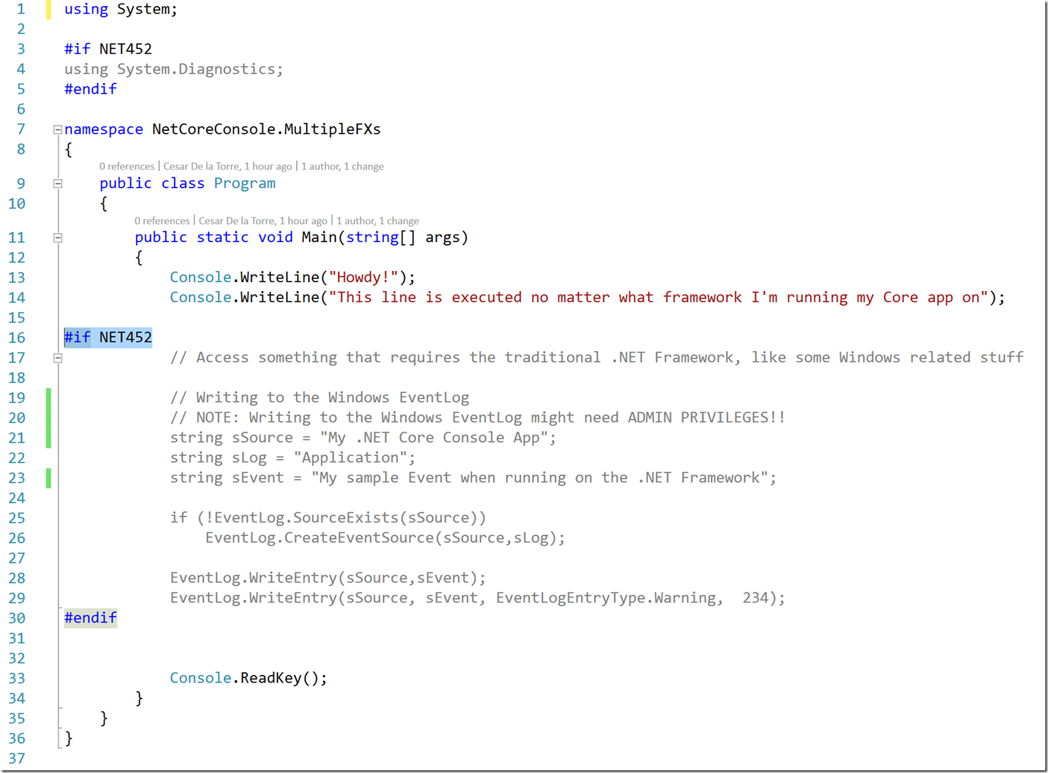
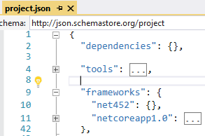
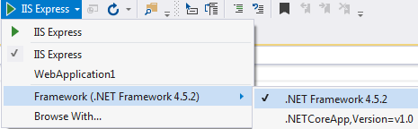
Precompiler Directives

Slide 12
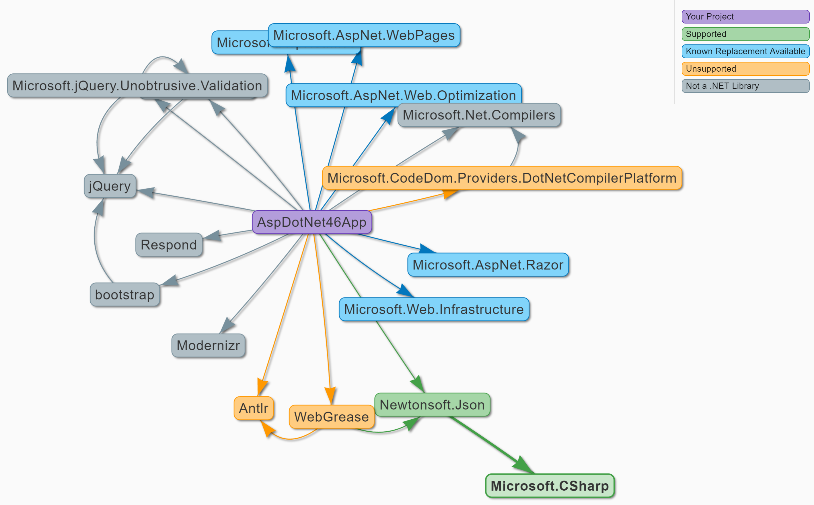
Portability Analyzers I Can Has .NET Core (https://icanhasdot.net/)
Notes:
Target .NET Framework 4.6.1+ as long as possible before switching to .NET Core
- Missing APIs available in .NET 4.6.1

Slide 13
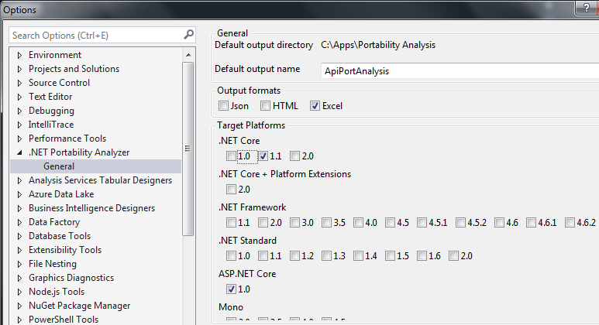
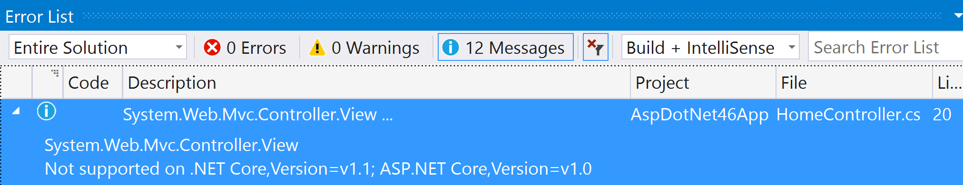
Portability Analyzers .NET Portability Analyzer (http://bit.ly/2llzOPS)
Notes:
Target .NET Framework 4.6.1+ as long as possible before switching to .NET Core
- Missing APIs available in .NET 4.6.1

Slide 14

.NET Portability Analyzer 3 Options
.NET Portability Analyzer
Console Application
Visual Studio Extension
.NET Core Application
Notes:
Extension only supported in VS 2015

Slide 15




.NET Portability Analyzer How It Works
Assemblies
Assemblies
ApiPort VS Extension
Portability Service
Notes:
Target .NET 4.6.1+ as long as possible before switching to .NET Core
- Missing APIs available in .NET 4.6.1

Slide 16

A Supplementary Resource
Telerik Developer Network article
Migration to ASP.NET Core: Considerations and Strategies
http://bit.ly/2lHxgyb
Notes:
Containers
No machine-wide installation
App isolated from machine-level patches

Slide 17





Thank you!
@Scott_Addie
scottaddie.com
github.com/scottaddie/slide-decks

